Slide 1
Open Source SDN: Protocol Independent Forwarding
Workday session / September, 2015

Slide 2
Open Source SDN Meeting Parameters
This is a reminder that all Open Source SDN meetings (sponsored by Open Networking Foundation) and activities are subject to strict compliance with the Open Networking Foundation's Antitrust Guidelines. Each individual participant and attendee at this meeting is responsible for knowing the contents of the Antitrust Guidelines, and for complying with the Antitrust Guidelines. Copies of the Antitrust Guidelines are available at: https://www.opennetworking.org/about/onf-operating-documents.
There are no specific IP agreements that guide these meetings. All communications should be construed as completely open and not subject to any pre-existing licensing or intellectual property regime from any organization, including those of Open Networking Foundation. All software that will be developed in these engagements will be licensed by a license that is in all respects an Apache 2.0 software license.

Slide 3


Introduction to PIF
September 10, 2015

Slide 4
PIF Open Source SDN software project … and also ONF Specifications Area group
Intermediate representation

Slide 5
Trajectory of PIF group
Initially
Within ONF
Members only
Standard ONF IPR policy
Focused project
Since May 2015
Open source, sponsored by ONF
Open to all contributors
Apache 2.0 license
Scalable project

Slide 6
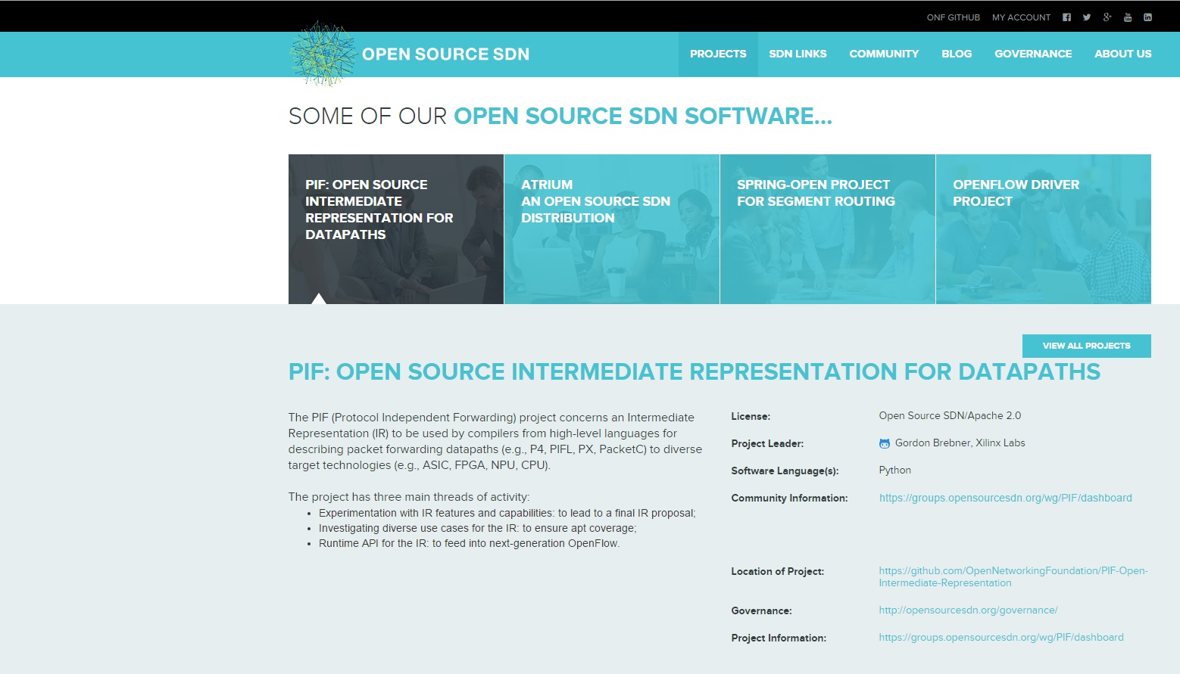
Open Source SDN presence opensourcesdn.org

Slide 7
PIF open source software project … and still ONF Specifications area group
Focus areas of PIF project:
Intermediate representation
IR elements
Use cases
Runtime APIs
Feeds into ONF “OpenFlow Next Gen” specification activity

Slide 8
Area 1: IR development topics
AIR-IRI open source code base is starting point
Improve/extend simulator
Associated tools
IR experiments
Review and understand current AIR components
Develop proposals for where information and constraints are best captured
Examples: parser, control program, traffic manager
Representation of expressions
Feedback from any back end experiments
These might be closed-source by vendors

Slide 9
Area 2: IR use cases
Catalog any existing programs/fragments
Review any known front end (e.g., P4) experience
Suggestions:
L4-L7
Tunnel
OpenFlow clone
… other OF-NG use cases as identified by Open DP WG
Move in direction of toolkit based on library components
Avoid duplication of effort

Slide 10
Area 3: IR run-time interface topics
Relationship to OF-Config and OF-Switch discussion
Relationship to Open DP WG lifecycle and temporal discussions
Validation framework for PIF

Slide 11
Summary of progress
Meeting since October 2014, open since May 2014
Over 100 people on original ONF mailing list
Around 70 people on new OSSDN mailing list
Much discussion about IR characteristics and IR SBI
Experience reports from Huawei, Netronome, Xilinx
Interaction with Flowgrammable.org
[Overlap with Open DP WG] Configuration time vs. run time

Slide 12
PIF workday session agenda
10:00 - 10:10: Introduction to PIF project, Gordon Brebner
10:10 - 10:55: Intermediate representation for PIF data paths
AIR-IRI for P4: Johann Tonsing (Netronome)
NetASM: Mohammed Shahbaz (Princeton)
BIR: Gordon Brebner (Xilinx)
10:55 - 11:15: Runtime interface to PIF data paths
AIR-IRI: Johann Tonsing (Netronome)
POF: Haoyu Song (Huawei)
11:15 - 11:30: Relationship between PIF and P4, Gordon Brebner
Call to action!

Slide 13
AIR/IRI IR additions for P4
Johann Tönsing / Netronome September 10, 2015

Slide 14
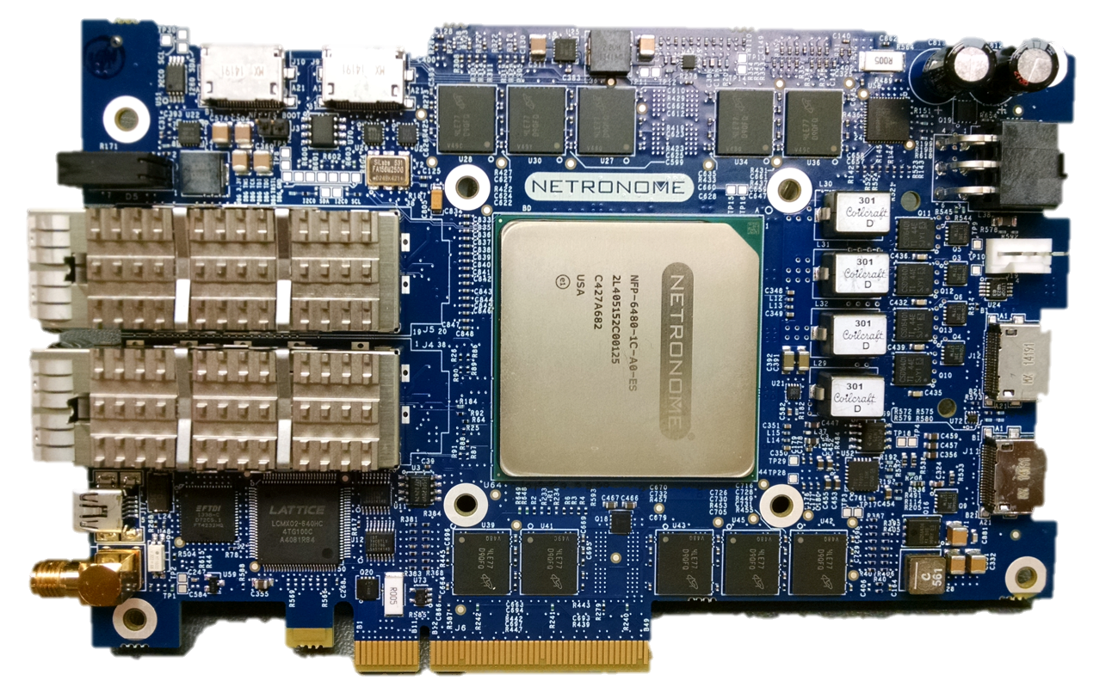
iNIC P4 + PIF IR Implementation:
Compilation + Development Environment
Parse - Match - Act
Dataplane Program
app.P4
Stateful / complex
packet processing code
Compile
plugin.C
P4 and C Integrated
Development
Environment
Edit - Build - Run
Intermediate Representation
ONF PIF => OpenSourceSDN.org
app.IR
=
Compile / Link
Debug
app.firmware
Native code
for NFP iNIC
Run-time interaction
Network
© 2015 Open Networking Foundation
NOT A CONTRIBUTION TO P4.ORG

Slide 15
Goals + Approach
Compile to Netronome Network Flow Processor native code
Support both P4 high level language and OSSDN IR (AIR-IRI)
Leverage existing P4.org high level language compiler
Translate P4 “HLIR” (Python objects in memory) to AIR-IRI (objects in YAML file)
Alignment between HLIR and AIR-IRI
Some constructs align well e.g. header definitions, parsing, control flow
Added constructs not covered yet
Added mechanisms for IDE integration and run-time interface
© 2015 Open Networking Foundation
NOT A CONTRIBUTION TO P4.ORG

Slide 16
IR Additions for Parsing
Setting metadata within parse node
Added “sets” key with array metadata refs
Value + Mask select values
Tagged transition with optional mask field: start -> parse_ethernet [value=0xdead, mask=0xffff]
Variable control flow entry point
Parser can 'jump' to any node in ingress/egress flow
© 2015 Open Networking Foundation
NOT A CONTRIBUTION TO P4.ORG

Slide 17
IR Additions for Control Flow
Conditional transition based on field values/header valid _condition_0: type : conditional format : pyexpr condition : (ingress_metadata.ingress_bypass == 0x0)
In digraph _condition_0 -> exit_control_flow [condition = false]
© 2015 Open Networking Foundation
NOT A CONTRIBUTION TO P4.ORG

Slide 18
IR Additions for Registers + Counters
Instantiation: cntr_direct: type : register class : global table : tbl_testval_0 instance_count : 4 fields : - value_bytes : 48 - value_packets : 32 counts : - bytes : value_bytes - packets : value_packets
Action: count(cntr_global.value_packets, 1); count_bytes(cntr_global.value_packets, 0); register_read(test_metadata.val32, cntr_global.value_packets) register_write(cntr_global.value_packets, 0)
Notes:
Registers and counters are declared in the same way
Counters have the addition 'counts' property
© 2015 Open Networking Foundation
NOT A CONTRIBUTION TO P4.ORG

Slide 19
IR Additions for Digests (Events)
Instantiation: test_event_field_list: type : field_list fields : - ethernet.dstAddr - test_metadata.val0 - test_metadata.val1 test_event : type : digest identifier : 1 field_list : test_event_field_list
Action: generate_digest(test_event);
© 2015 Open Networking Foundation
NOT A CONTRIBUTION TO P4.ORG

Slide 20
IR Additions for Header Stacks
Instantiation: vlan : type : header max_depth : 5 fields : - pcp : 3 - cfi : 1 - vid : 12 - etherType : 16
Action: remove_header(vlan[1]); pop(vlan, 2); remove_header(vlan[last]);
Control flow: valid(vlan[0]) vlan[1].vid vlan[last].vid
© 2015 Open Networking Foundation
NOT A CONTRIBUTION TO P4.ORG

Slide 21
IR Additions for Development Environment
Source info section: date, revision strings, source files, output file name... source_info : type : source_info date : 2015-06-30 09:03:35 source_files : ...
Source filename and line number per object
Allows mapping AIR-IRI output to original P4 source
© 2015 Open Networking Foundation
NOT A CONTRIBUTION TO P4.ORG

Slide 22
The Case for an Intermediate Representation for
Programmable Data Planes
Muhammad Shahbaz / Princeton September 10, 2015

Slide 23

Need for a Programmable Data Plane
Protocol Independence (e.g., GRE, VXLAN, BFD)
VXLAN
ETH
Payload
ETH
Payload
Data Plane
ETH
Payload
P0
LD VXLAN
LD ETH
VXLAN.IP
==
IPx
ETH
==
ETHy
POP VXLAN
SEND P0
To enable this, data plane needs to be able to …
1) Operate on arbitrary packet locations
2) Accept packet processing operations using high-level policies
(or language)
Policy
Notes:
First let’s talk a bit about why we need a programmable data plane
What is it that current (fixed function) switches are not able to provide.
[Click]
“Protocol Independence” – The fixed nature of OpenFlow devices makes it hard to add new protocols or (infact) remove protocols if they are no longer needed.
Recently many new protocols are being developed for serving different applications in datacenter and enterprise networks e.g., GRE, VXLAN, and BFD.
And there is a need to rapidly deploy those protocols in the network without waiting for new OpenFlow specification and chips to spin up (which if not years, tends to take months before they can be actually deployed)
Therefore, it seems reasonable to have some kind of programmability in the network device to quickly deploy these protocols.
[Click]
The data plane device should be able to operate on arbitrary packet locations.
It should provide means for specifying packet operations using high-level network policies.
[Click]
For example, here’s a simple network policy that tells that data plane to read VXLAN and (internal) Ethernet headers from the packet.
Compare the IP in VXLAN with some IPx. If there is a match it removes the VXLAN header from the packet and forwards it through port 0 if internal ETH header matches.
[Click]
Given such programmable devices, the challenge then is how to compile these high-level user policies to such devices.

Slide 24


Compiling Policy
b. generate policy
Switch
a. git clone
Parse
ETH
DC
Parse
ETH
Parse
IP
ACL
Parse
IP
LB
HUB
Parse
TCP
Router
ACL
c. install policy
However, there is an issue here …
- ACL might only be operating on IP src/dst
- In which case, rest of the fields are dead
- A naïve compilation will add these dead fields in the data plane
Data Plane
Notes:
[Click]
We expect that programmers will organize their policies into libraries and modules, possibly, written in different languages (e.g., P4 and POF).
These libraries might be accessible through public repositories like Github.
[Click]
A network programmer can then take these modules and compose them to write more complex policies.
[Click]
And finally install them on to a data plane device.
[Click]
However, installing policies is not straight forward. There are many challenging issues here. For example, ACL might only be operating on IP src/dst.
In which case, rest of the fields are unused and shouldn’t be part of the final policy.
[Click]
But a naïve compilation will add these fields in the data plane
Thus, we need mechanisms to ensure that such redundancies be removed from the final policy and that it’s efficiently compiled to the underlying target.

Slide 25
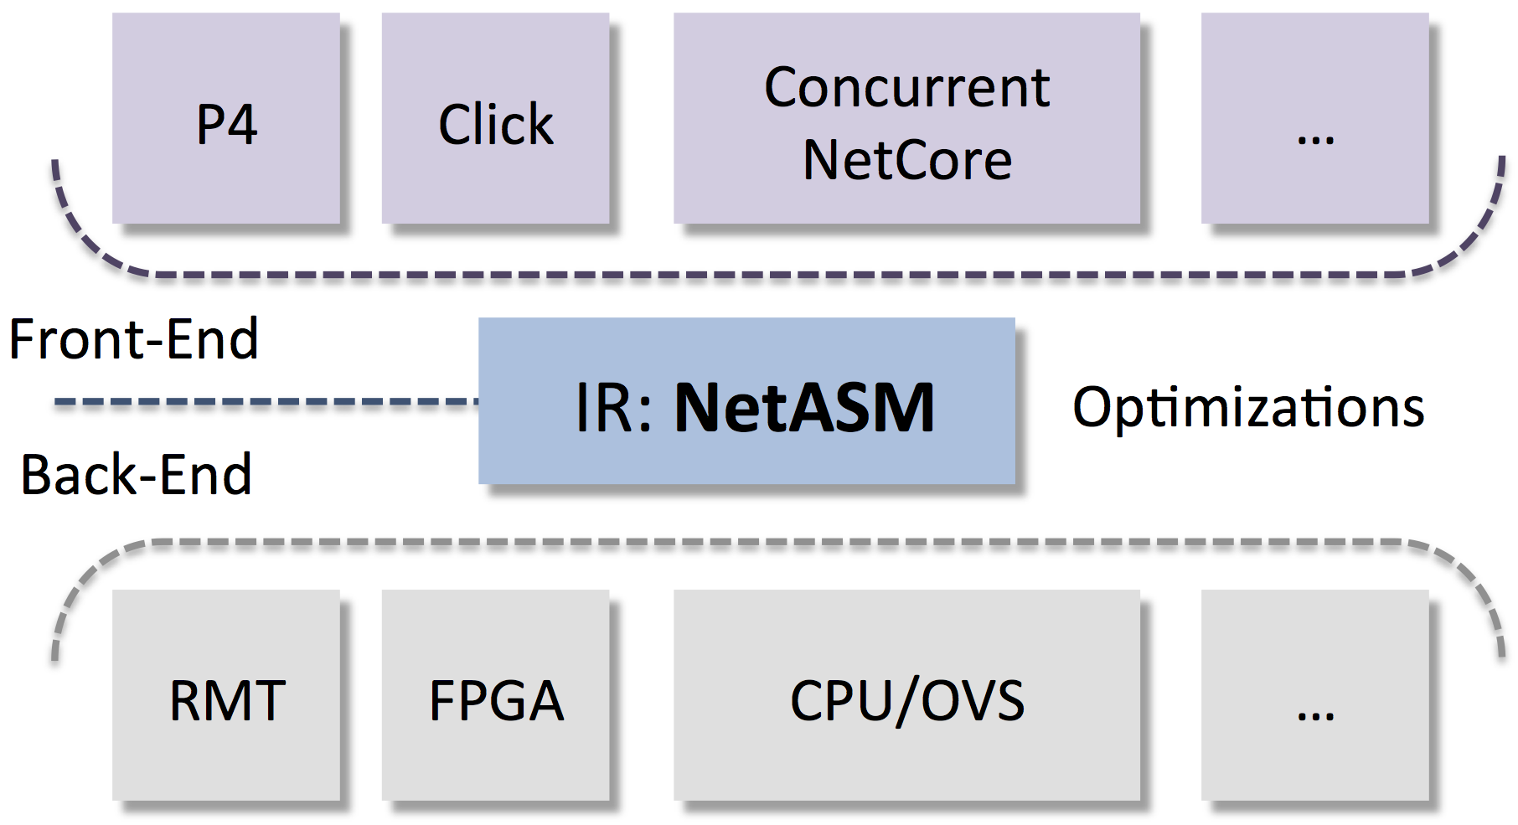
NetASM: An Intermediate Representation
Enables a common platform for writing optimizations for programmable data planes
NetASM Design Features
- Provides an abstract data plane model
- Two kinds of state
a. Per-packet state (e.g., fields)
b. Persistent state (e.g., tables)
- Modes of execution
a. Sequential for invoking pipelined parallelism
b. Concurrent for latency sensitive applications
c. Atomic for stateful operations using shared state
- 23 primitive instructions
Notes:
To tackle this problem, we present NetASM which serves as the “narrow waist” between the languages that are beginning to emerge and rapidly growing set of targets.
[Click]
It enables a common platform for writing optimizations for these programmable devices.
[Click]
Provides an abstract cost model.
[Click]
Persistent state for storing information across packets.
[Click]
In order efficiently map policies to different targets, NetASM provides three modes of execution.
These can be used in conjunction to implement complex execution behaviors of a given device.
[Click]
And has only 23 primitive instructions for implementing these network policies.

Slide 26
Compiling Policy “using NetASM”
Parse
ETH
Parse
IP
ACL
NetASM acts as a common (intermediate) layer
- Improves quality of code using optimizations like
code-motion and dead-code/store elimination
NetASM
Common (Intermediate) Layer
- Performs conventional data and control flow
analyses
- Uses target agnostic and specific cost model
- Improves for metrics like area, latency, and throughput
Data Plane

Slide 27
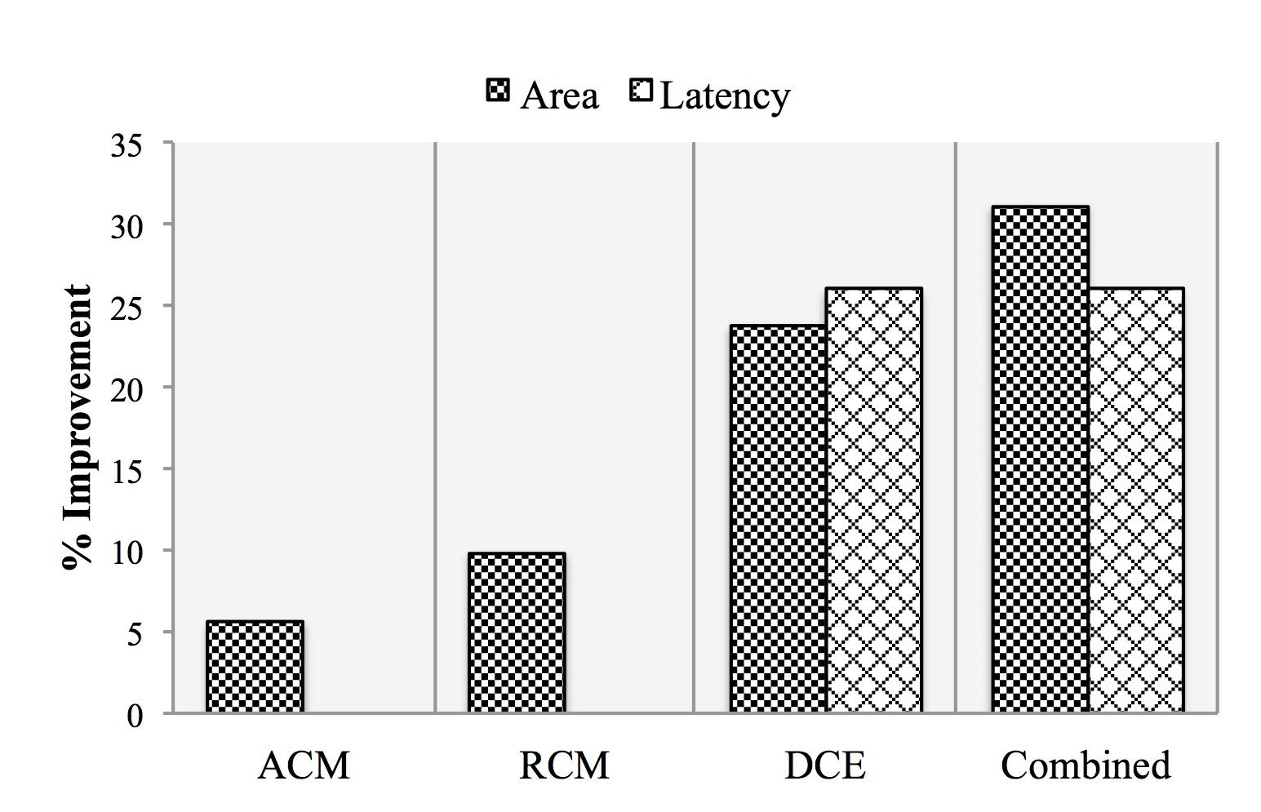
Preliminary Evaluations
- ACL-IPv4 benchmark from ONF Github repository
https://github.com/NetASM/ACL-IPv4-Example
- Results using our abstract cost model (details in SOSR 2015 paper)
Notes:
We have done some preliminary evaluations using the ACL-IPv4 benchmark from ONF Github repo.
We translated the original TTP specification into NetASM and wrote a packet parser and deparser for it.
As it’s was not originally specified under TTPs.
We ran these optimizations using an abstract cost model. The details of which are listed in the paper.
We found that by just running few simple code-motion and dead-code elimination optimizations we were able to remove many of the redundancies in the ACL+IPv4 policy.
There was around 32% and 26% increase in the area and latency, which showed the viability of our work.

Slide 28
Future Work
P4
Click
CNC
Complete the language specification for NetASM
Front end
Explore opportunities for optimizations
that can be applied across different classes of target architectures
Compiler
NetASM
Back end
RMT
FPGA
NPU
1
2
3

Slide 29
Summary
NetASM is an intermediate representation for Programmable Data Planes
Enables a common platform for optimizing high-level packet processing programs for a diversity of targets
Leads to better architectural explorations
Notes:
We presented NeASM an intermediate representation for programmable data planes.
NetASM provides a common platform for optimizing packet processing programs for a diverse set of targets.
And we hope that it will lead to better architectural explorations and soon a time will come when the performance of the switch will not be determined by its raw speed but also by how well compilers can exploit its features.
With this I conclude my presentation.

Slide 30
BIR (pronounced “beer”)
Gordon Brebner / Xilinx September 10, 2015

Slide 31
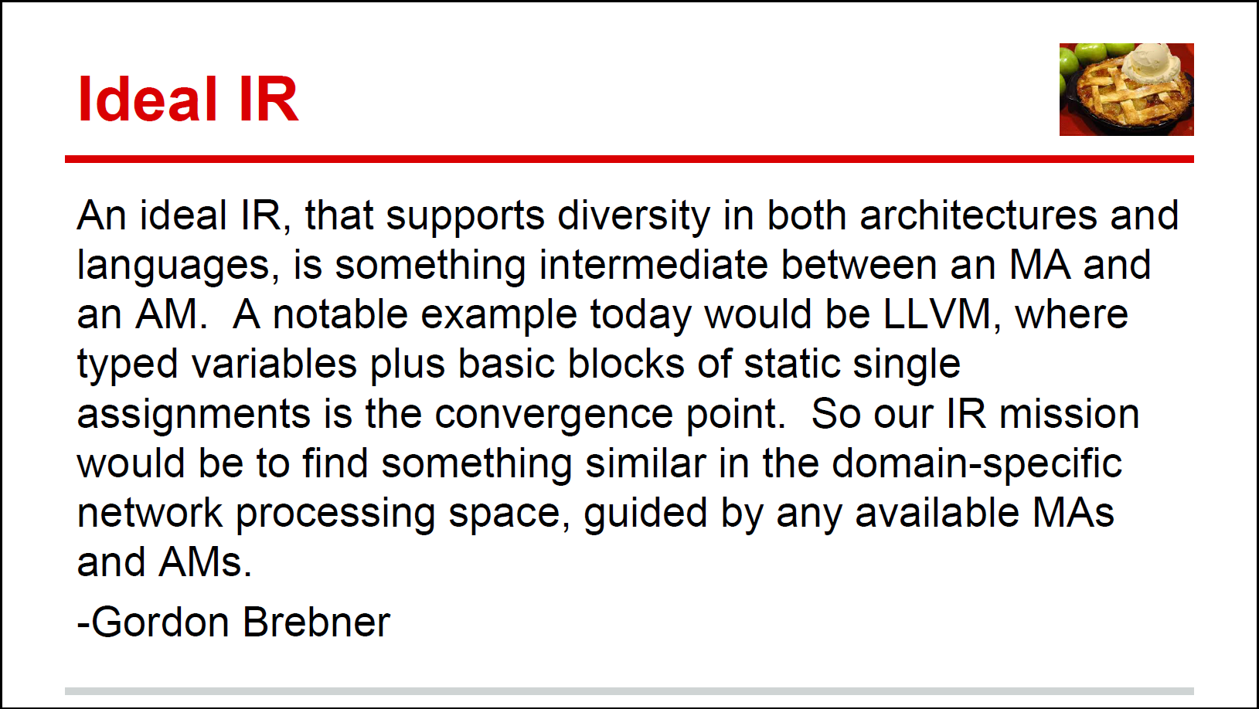
Old ‘Motherhood and Apple Pie’ slide
Source:
PIF Update
Dan Talyco
October 9, 2014
Glossary:
MA =
Machine Abstraction
(of hardware)
AM =
Abstract Machine
(for software)
p.s. It should not lose or obscure useful higher-level information that is not easy to reconstruct or rediscover at a lower level

Slide 32
BIR: the “B” IR
Intended to capture the different threads of IR-related discussions
Intended to be at the “right” level for this domain-specific IR
Intended to be more language/target neutral than the AIR/IRI IR
Proposal for an IR spec for wider review and discussion
Open source software simulator based on AIR-IRI infrastructure

Slide 33


Main influences
PIF group discussions
P4, RMT, AIR-IRI
school
BIR
POF
school
NetASM
school
PX
school
rather than
Design

Slide 34
Key characteristics
Top-level static packet data flow graph (linear pipeline at first)
Each node is a “packet processor”
Either a “control flow”: programmed processor
Or an “other processor”: supplied processor
A control flow involves traversing “basic blocks” to completion
Captures both parsers and table match-action pipelines
A basic block:
Has optional defined local contexts of: header type, table
Is passed a packet and an offset into the packet – where header is mapped
Carries out header/metadata updates and/or calls on supplied methods
Calculates next offset and next basic block
Expressions are atomic
Tables are header-in, header-out (not match-action abstraction)

Slide 35
Using the AIR meta infrastructure New meta.yml specification (current draft)
# These are the recognized top level BIR object types
air_types :
- header
- metadata
- table
- other_object
- basic_block
- control_flow
- other_processor
- processor_layout
# These BIR objects must implement a process method
air_processors :
- control_flow
- other_processor
# These are the attributes each object type supports
# All objects support the type and doc attributes
air_attributes :
header :
- fields
metadata :
- fields
- initial_values
table :
- type
- depth
- request
- response
- operations
other_object :
- operations
basic_block :
- local_header
- local_table
- instructions
- next_offset_block
control_flow :
- start_offset_block
other_processor :
- operation
processor_layout :
- format
- implementation

Slide 36
Mapping AIR-IRI types to BIR types
Header
Metadata
Table
Action
Parse_state
Parser
Control_flow
Traffic_manager
Processor_layout
Value_set
Value_map
Header
Metadata
Table
Basic_block
Control_flow
Other_processor
Processor_layout
Other_object

Slide 37
Control flow
Recognizes that packet processing is driven by two dynamic factors:
Packet data (data plane input)
Table data (control plane input)
Context for a basic block:
Particular header in packet: can be read or written
Particular table:
Lookup takes a struct containing expressions
Result is a struct containing values: some can be decoded as actions
Using metadata associated with each packet
Can represent fine- and coarse-grain parsing and match-action
Not defined as a graph, edges come dynamically from bb transitions

Slide 38
Expressions
Expressions may be used widely
Constructing lookup keys
Updating packet fields
Computing next offset and next basic block
Conditionals
Certain languages/targets may restrict generality of expressions
Expressions not broken down further into simple operations
This left to target-specific backends for implementation

Slide 39
Tables
Not represented as match-action tables in the OpenFlow sense
Lookup key is arbitrary struct of expressions
Not just a selection of fields
Result is arbitrary struct of values
Not just a selection of pre-defined actions, generally a source of operands
Some expressions can be interpreted as actions in basic block
Table is closer to real table implementations
Standard exact match, LPM, TCAM, types

Slide 40
Status
In preparation Aug/Sep 2015
Code base not quite ready for workdays – few more weeks
Will seek feedback from PIF, CAB, P4
Has involved refactoring original AIR/IRI code base

Slide 41
Run-Time Interface Considerations
Johann Tönsing / Netronome September 10, 2015

Slide 42
iNIC P4 + PIF IR Implementation: Run-Time Interaction
SDN
Controller
Toolchain
OpenFlow ++
VNF or L4-L7
or other app
app.firmware
Native code
for NFP iNIC
OpenFlow
Agent
Callable API
e.g. Thrift
API
Network
Generated CLI
vs API driven CLI
table_data.JSON
Debug API
Debug
table_info.JSON
Vendor specific
e.g. memory layout
Describe tables, action data
=> generated model (TTP )?
© 2015 Open Networking Foundation
NOT A CONTRIBUTION TO P4.ORG

Slide 43
Run-time Interface Details
Workflow options
Create model (~ .h file), then write program (~ .c file) to conform
Create program, then extract interface (model, API…) from it
Generated items
Model
Consumed by tools, controller etc.
Negotiated too?
Interface
Example: “IDL” for Thrift => callable API (C, Python…)
Vendor/implementation specific debug info
Schema and encoding of items can be discussed
Prototype: model in purpose specific JSON format
Create Table Typing Pattern (TTP), or new instance of Negotiable Datapath Model (NDM)?
© 2015 Open Networking Foundation
NOT A CONTRIBUTION TO P4.ORG

Slide 44
POF Southbound Interface
Haoyu Song / Huawei September 10, 2015

Slide 45
OpenFlow
OpenFlow is a protocol handling both configuration and runtime
Configuration: table, queue, groups …
Runtime: table entry manipulation
Pros:
Simple: one protocol for both
Agile: dynamic reconfiguration
Flexible: allow other means to directly reprogram the data path (e.g. CLI)
Cons:
Too flexible for some less flexible target for unconstrained usage
The cons can be amended by enforcing constraints. It can’t be used as an excuse to limit the flexibilities

Slide 46
Suggestion to Next Gen OpenFlow
Protocol independent
Keep the merit of a single protocol
Keep the simple forwarding model
Do not reinvent the wheels
Port
or
Black Box
Table
Action
Port or Black Box
Table
Action
Table
Action
(parse, edit, etc.)

Slide 47

POF Ecosystem – An Open Architecture
POF covers an entire ecosystem,
programming language (e.g., P4) is a component in this ecosystem
POF ecosystem centered on an open SBI
Current protocol is based on an extension of OF1.x
No explicit separation of configuration time and run time
Forwarding abstraction delivered through a set of primitive instructions
Application
High level language/ Compiler
Library
GUI/CLI
Open Southbound Interface
(OF2.0?)
Device / Driver
Programmable Chip

Slide 48
Key Objects at POF SBI
Name | Description
Protocol | Define the protocol header fields
Metadata | Define the metadata layout
Table | Define table name, table type, table size, search key, and if the table is a shared table
Table Parameter | Define parameter format for each table that can be accessed by table instruction block (aka action)
Instruction Block | Define the actions that will be executed after table matching. Each table entry will point to an instruction block.
Service | Define the table pipeline (similar to control flow in P4)

Slide 49
POF SBI Objects
Service (Table + Instruction Block) forms the main MAT pipeline
Instruction block is a piece of code written in primitive instructions
Equivalent to table action in P4, but more flexible
No instruction count limits; has conditional branching capability
These lower level objects can be compiled from a high level language such as P4
Can be considered as a kind of IR
Don’t care physical implementation, but care physical resource sharing
SBI uses OF messages to download these objects to data plane devices

Slide 50
POF SBI Protocol – Message & Instruction
Support all existing OF1.4 messages
Add new POF-specific messages starting from ID# 101
Counter messages
Instruction block message
POF enable/disable messages
Service messages
A few other extensions.
All messages carries the same OpenFlow message header format, some message bodies are modified to fit for POF’s requirement
E.g., table_mod, flow_mod, etc.
Editing:
OFPIT_POF_SET_FIELD = 0X8001,
OFPIT_POF_ADD_FIELD,
OFPIT_POF_DEL_FIELD,
OFPIT_POF_CALCULATE_FIELD,
OFPIT_POF_COMPARE,
OFPIT_POF_ALG,
Table & Parsing:
OFPIT_POF_GOTO_TABLE,
OFPIT_POF_GET_TABLE_ENTRY
OFPIT_POF_SET_TABLE_ENTRY,
OFPIT_POF_SET_PACKET_OFFSET,
OFPIT_POF_MOVE_PACKET_OFFSET,
Forwarding:
OFPIT_POF_OUTPUT,
OFPIT_POF_DROP,
OFPIT_POF_TOCP,
OFPIT_POF_COUNTER,
OFPIT_POF_METER,
Control Flow:
OFPIT_POF_ABSOLUTE_JMP,
OFPIT_POF_RELATIVE_JMP,
OFPIT_POF_ CONDITIONAL_RELATIVE_JMP,
OFPIT_POF_BRANCH,

Slide 51
Summary
POF ecosystem advocates open interface for both data-plane programming (configuration) and operation (runtime)
Configuration and runtime can be unified to maximize the flexibility
POF SBI is based on OpenFlow 1.4 and adds minimum extensions
Objects at SBI is a form of IR
P4 can be used as a high level language in POF ecosystem
P4 program can be compile to POF IR and use POF SBI to program devices
Extended OpenFlow interface can still be an open SBI for the next generation programmable data plane.

Slide 52
Relationship between PIF and P4
Gordon Brebner / Xilinx September 10, 2015

Slide 53
P4
New P4 consortium at P4.org
First P4 Workshop at Stanford in June 2015
Appeared first in paper published in July 2014
P4: Programming Protocol-Independent Packet Processors
P. Bosshart, D. Daly, G. Gibb, M. Izzard, N. McKeown, J. Rexford, C. Schlesinger, D. Talayco, A. Vahdat, G. Varghese, D. Walker
P4 is a high-level language for programming protocol-independent packet processors. P4 works in conjunction with SDN control protocols like OpenFlow. In its current form, OpenFlow explicitly specifies protocol headers on which it operates. This set has grown from 12 to 41 fields in a few years, increasing the complexity of the specification while still not providing the flexibility to add new headers. In this paper we propose P4 as a strawman proposal for how OpenFlow should evolve in the future. We have three goals: (1) Reconfigurability in the field: Programmers should be able to change the way switches process packets once they are deployed. (2) Protocol independence: Switches should not be tied to any specific network protocols. (3) Target independence: Programmers should be able to describe packet processing functionality independently of the specifics of the underlying hardware. As an example, we describe how to use P4 to configure a switch to add a new hierarchical label.

Slide 54
PIF and P4 relationship
P4: Programming language
PIF: Intermediate representation

Slide 55
PIF and P4 activities
PIF
Design of IR features
Investigate IR use cases
Runtime API for IR data path
Compilers to targets
Multiple and emergent languages
Attempt to cover all targets
P4
Design of P4 features
Investigate P4 use cases
Runtime API for P4 data path
Compilers to targets
Single language
Some targets more natural

Slide 56
PIF and P4 operational
PIF
Weekly phone webex
Email discussions
Working on the basis for an IR spec
Open source software project
Several activists also in P4
P4
Biweekly in-person meeting
Email discussions
Working on next version of P4 spec
Open source software project
Several activists also in PIF

Slide 57
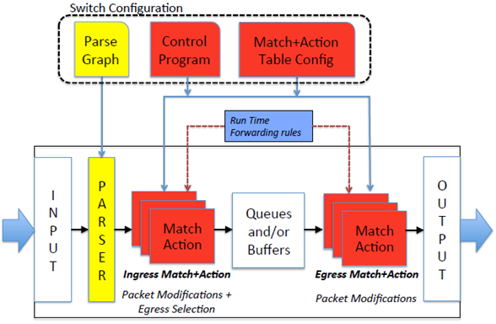
PIF ARI-IRI IR and P4
Many similarities
Headers and metadata
Initial parser, and final deparser, model
Match-action table control flows
Simple traffic manager (not explicit in P4 language though)
DEPARSER
P4 switch architecture

Slide 58
Main changes for P4 1.1 spec (Nov 2015)
Language/architecture separation
Don't mandate a "Parse->Ingress->Egress" architecture in the spec
Allow expression of this and other architectures, but only partially in P4
Extensibility (“black boxes”)
Allow vendors and libraries to expose new kinds of objects (meters, … )
Composability (“white boxes”)
Allow code to be reusable
Simplify the core spec (move things to libraries, tidy up syntax)
Fewer primitive actions, keywords, special semantics, ...

Slide 59
Call to action
September 10, 2015

Slide 60
Ways to participate in the PIF project
Best:
Write code contributions
Volunteers wanted today
Increase diversity of opinions
And:
Experiments using existing code
Active participation in weekly PIF call
Join in PIF email discussions
But understand:
PIF output is code, and documentation derived from code
A “Python” group, as opposed to a “PDF” group

Slide 61
How to join in the PIF project
PIF Open Source SDN project at:
https://groups.opensourcesdn.org/wg/PIF/dashboard
Contains calendar, mail archive, documents, etc.
Warning: many documents still “in transit” between ONF and OSSDN
PIF GitHub:
https://github.com/OpenNetworkingFoundation/PIF-Open-Intermediate-Representation
Join the weekly call:
Tuesdays 11am -12 noon Pacific
See calendar entry for full information
Join the mailing list (pif@groups.opensourcesdn.org)

